Slide 1



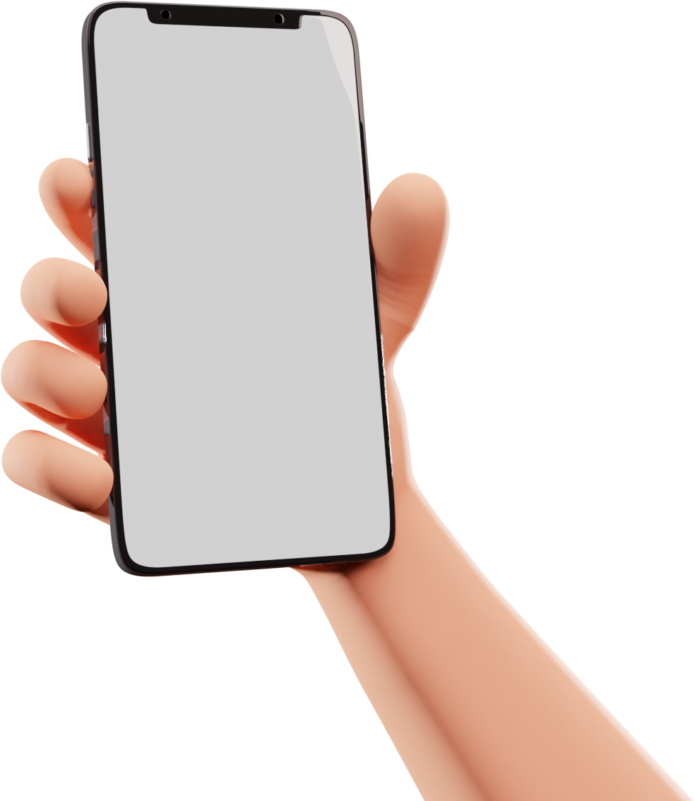

CHAT APPLICATION
Merry Christmas
& A Happy New Year!
from the Johnsons
PRESENTATION
Group No:-GB-09

Slide 2
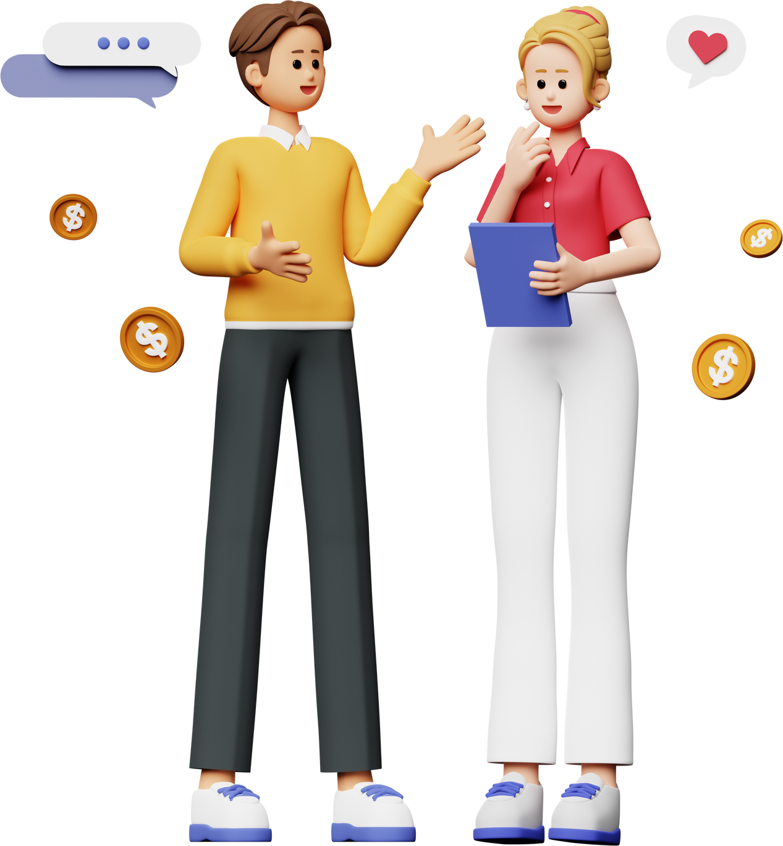


TEAM
MEMBER
Supervisor:- Mr. Rabi N. Panda
Hayat Khan(LEADER) 2200290140069,
Harshita Tyagi 2200290140068,
Gaurav Prajapati 2200290140061

Slide 3



INTRODUCTION
The Chat Application is a real-time platform built using the MERN stack, facilitating instant messaging between users. It utilizes MongoDB for data storage, Express.js for backend development, React.js for frontend interface, and Node.js for server-side operations, enabling seamless communication and interaction in real-time.

Slide 4


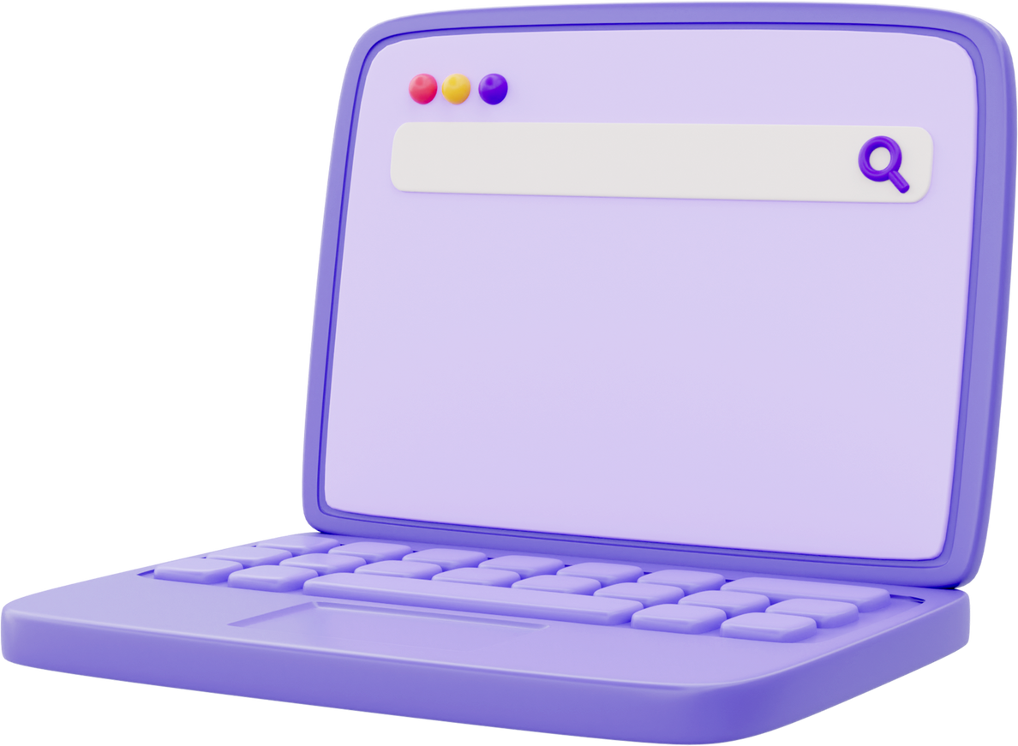
TECHNOLOGIES
AND SOFTWARE REQUIREMENT
Technologies
MongoDB,
Express.js,
React.js,
Node.js,
WebSocket Protocol,
Socket.IO
Software
MongoDBCompass,
Visual Studio Editor

Slide 5

HARDWARE
REQUIREMENT
Processor: Intel Core i5 or equivalent
RAM: Minimum 8GB
Storage: SSD
Network Interface: Gigabit Ethernet
/user

Slide 6

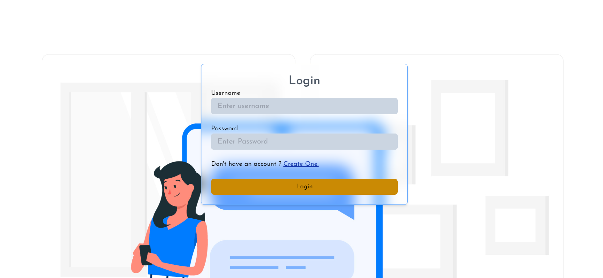
LOGIN

Slide 7

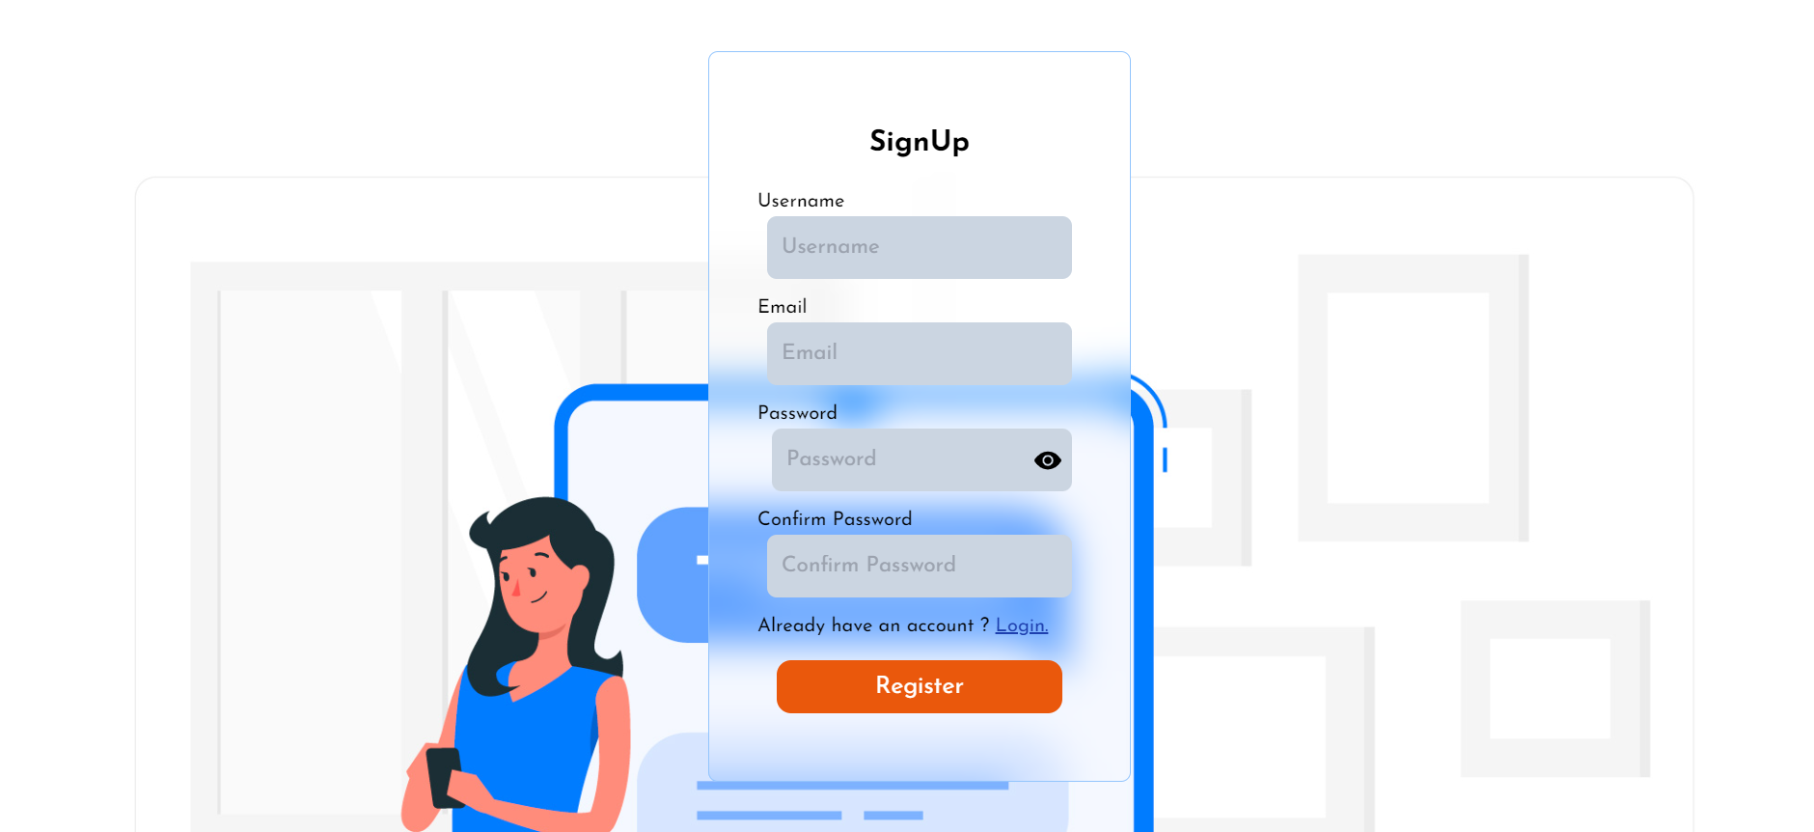
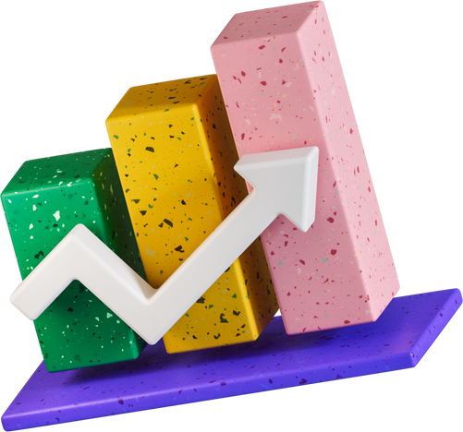
SIGN UP

Slide 8
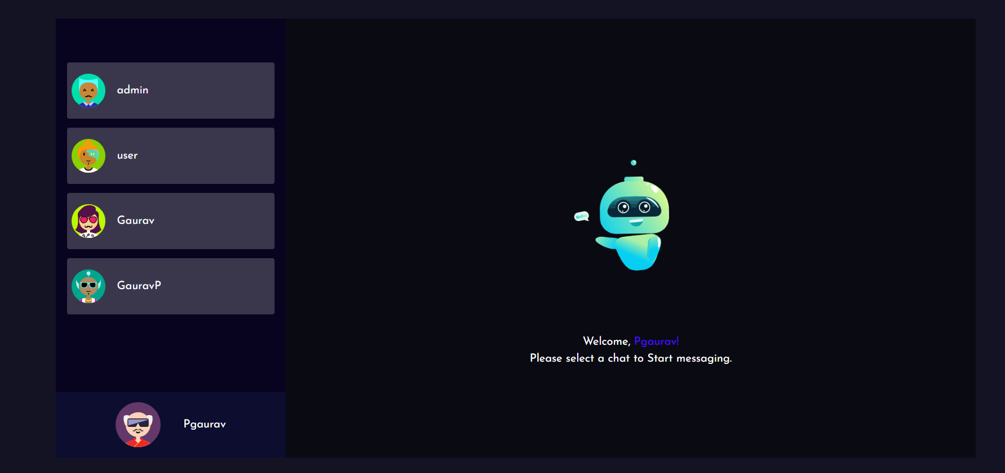
MAIN VIEW
/user

Slide 9
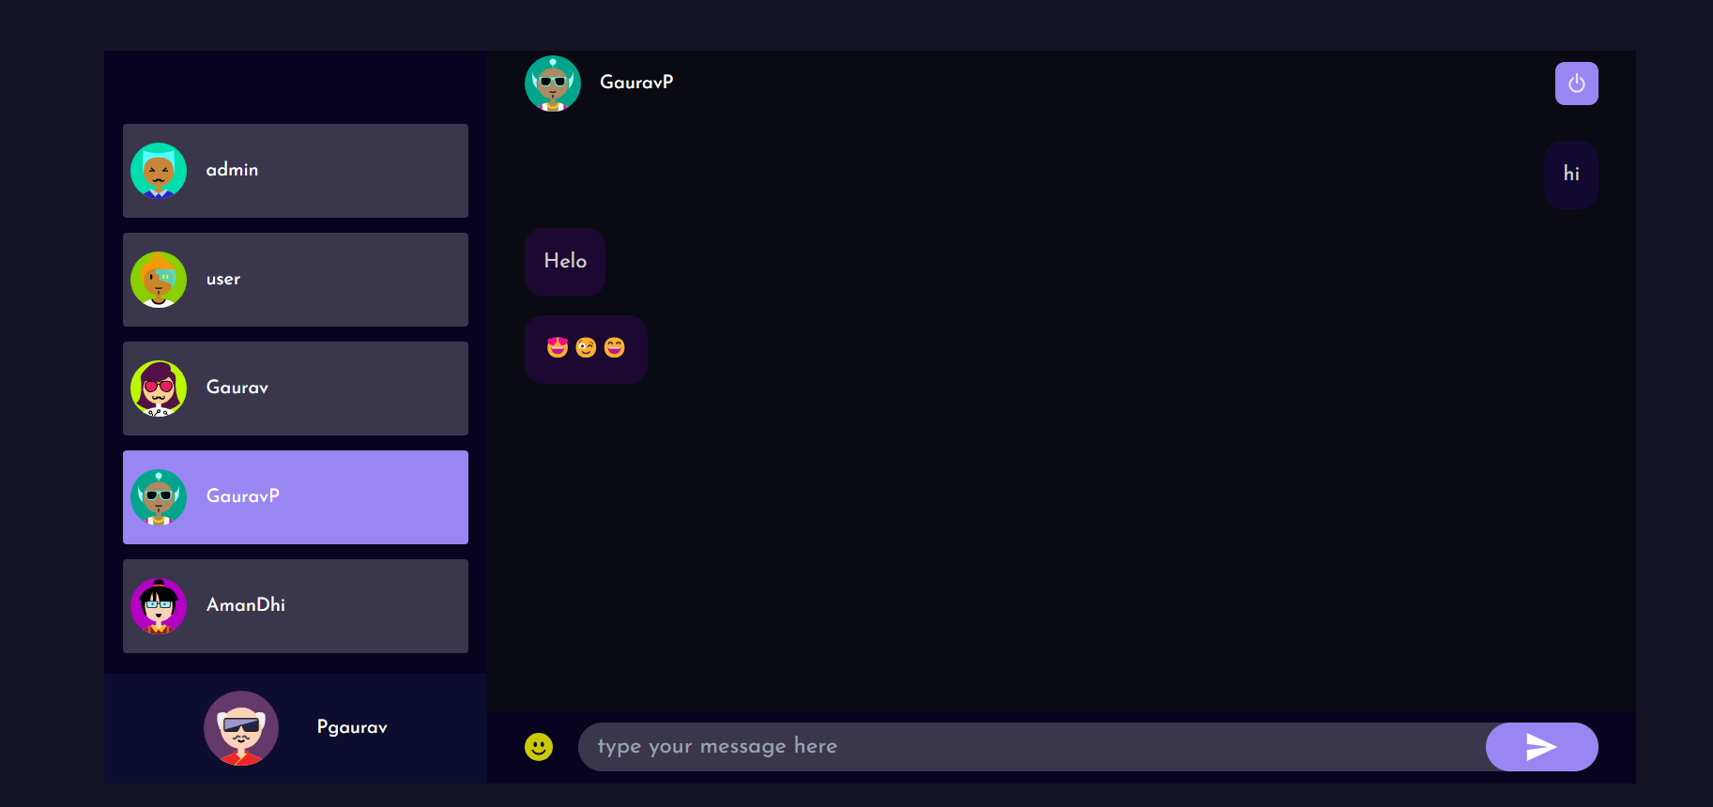
CHAT VIEW
/user

Slide 10
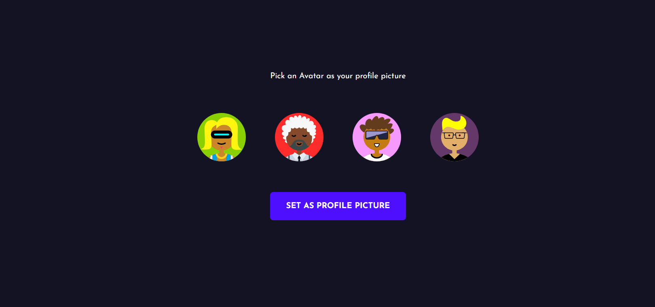
CREATIVE AVATAR SELECTION

Slide 11

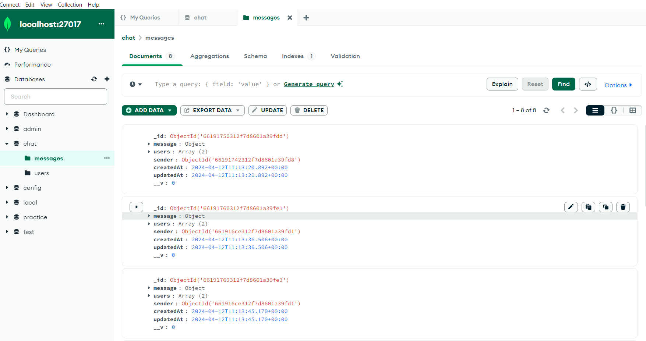
DATABASE
(MONGO-DB)

Slide 12
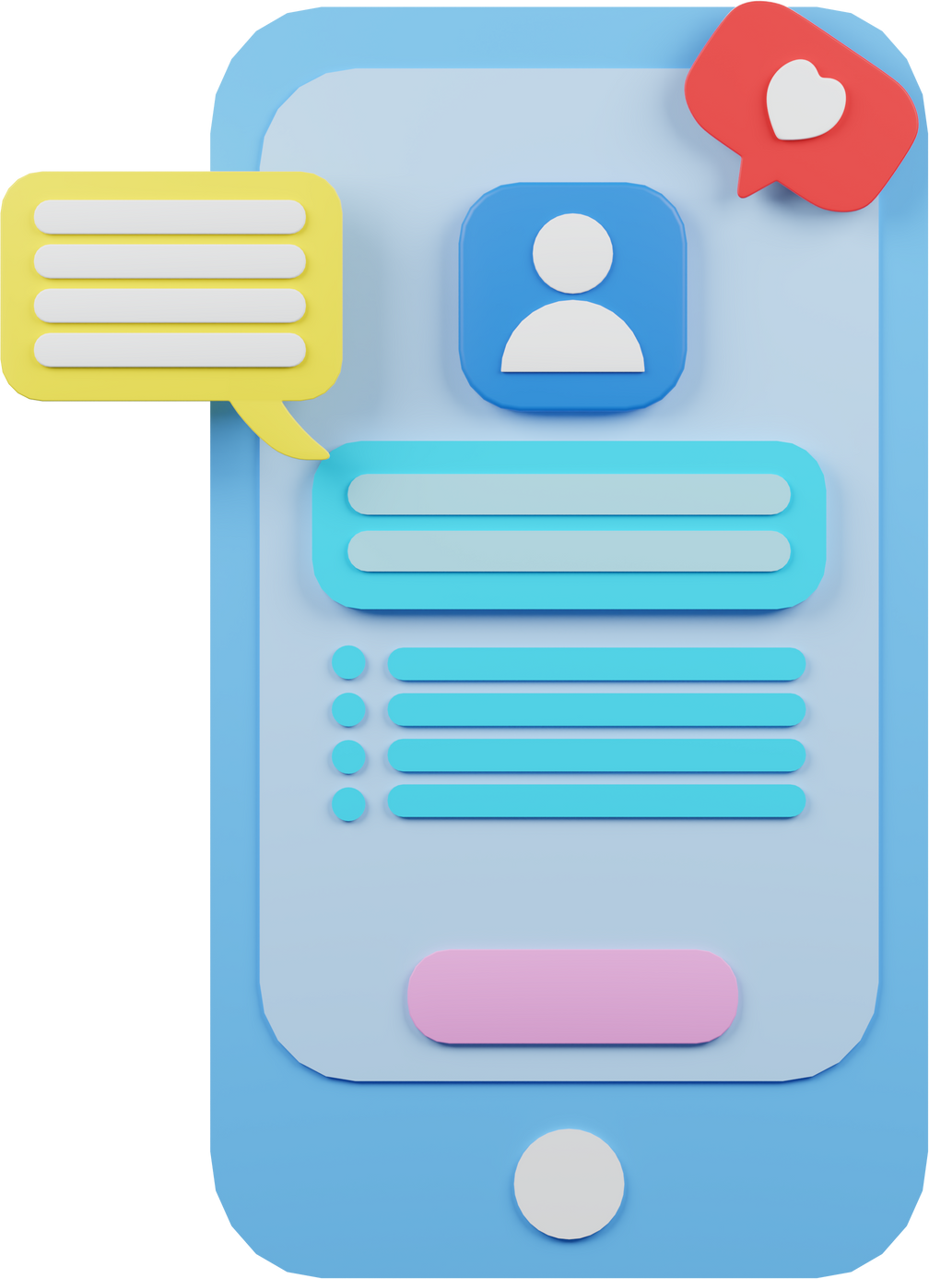

REPORTS / OUTPUTS
Presentation of data or findings
Generated documents or files
Visual representations such as charts or graphs
Automated reports
Data exports in various formats
Alerts or notifications

Slide 13
GANTT CHART
Product Launch Plan
Week 1
Week 2
Week 3
Week 4
Week 5
Week 6
Requirement Analysis
Feasibility Study
Coding
Testing
Presentiation
Deployment

Slide 14

